Slide 1
SMS Spam Detection using GAN
Created by
M . MADHESHWARAN
Reg.No.:912321104019
III-year , CSE
SACS MAVMM ENGINEERING COLLEGE

Slide 2
Project outline:
Problem statement
Proposed system/solution
System development approach
Algorithm and deployment
Result
References
conclusion

Slide 3
Problem Statement:
Develop a SMS spam detection system using Generative Adversarial Networks (GANs) to distinguish between spam and legitimate messages. The goal is to create a model capable of accurately classifying incoming text messages as either spam or non-spam, leveraging the discriminative power of GANs to enhance detection performance while minimizing false positives and negatives.

Slide 4
Proposed system/solution:
1.Data Collection and Preprocessing:
Gather a large dataset of SMS messages, labeled as spam or non-spam. Preprocess the text data, which may involve tokenization, lowercasing, removing punctuation, and stemming or lemmatization.
2.GAN Architecture:
Design a GAN architecture suitable for text data. Unlike image-based GANs, text-based GANs may utilize recurrent neural networks (RNNs) or convolutional neural networks (CNNs) for both the generator and discriminator networks.

Slide 5
Proposed system/solution:(contd…)
3.Generator Network:
The generator network in the GAN is responsible for generating synthetic SMS messages. It learns to generate realistic-looking messages based on the patterns it learns from the training data.
4.Discriminator Network:
The discriminator network is tasked with distinguishing between real and synthetic SMS messages. It learns to differentiate between legitimate messages and spam based on the features of the text.

Slide 6
Proposed system/solution:(contd…)
5 . Training Process:
The generator and discriminator networks are trained in an adversarial manner. The generator tries to generate realistic messages to fool the discriminator, while the discriminator tries to accurately classify real and synthetic messages. This adversarial training process helps both networks improve over time.
6 . Evaluation and Validation:
After training the GAN, evaluate its performance on a separate validation dataset. Measure metrics such as accuracy, precision, recall, and F1-score to assess how well the model can distinguish between spam and non-spam messages.

Slide 7
System Development Approach: [Hardware Requirements]
CPU: CPU can handle machine learning tasks, training deep learning models like GANs is computationally demanding.
GPU: GPU can highly recommended for deep learning tasks due to their parallel processing capabilities. NVIDIA GPUs are commonly used for deep learning projects.
Memory management [RAM]: Aim for at least 16GB to 32GB of RAM for moderate-sized datasets and model architectures. Consider the capacity for future scalability.
Hard Disk Drive[HDD]: Consider using HDDs for backups or storing historical data.

Slide 8
Software Requirements:
1. GAN Framework:
Choose a deep learning framework that supports GANs, such as TensorFlow, PyTorch, or Keras. These frameworks provide APIs for building, training, and evaluating GAN models.
2. Data Preprocessing Tools:
Use tools like Python libraries (e.g., NLTK, scikit-learn) for preprocessing SMS data, including text tokenization, normalization, and feature extraction.

Slide 9
Software Requirements:(contd…)
3.Development Environment:
Set up a development environment with the chosen deep learning framework, along with necessary libraries and packages. Virtual environments (e.g., Anaconda) can help manage dependencies.
4.Training Infrastructure:
If training on large datasets or complex models, consider utilizing cloud-based GPU instances (e.g., AWS EC2, Google Colab) to speed up the training process. Alternatively, you can use local GPUs if available.

Slide 10
Algorithm and deployment
Problem Statement: Identify whether an incoming SMS message is spam or not.
Input: SMS messages containing text content.
Output: Classification label indicating whether the message is spam (1) or not spam (0).

Slide 11
Algorithm steps:
a. Preprocessing:
Tokenization: Split each SMS message into individual words or tokens.
Text cleaning: Remove stop words, punctuation, and special characters.
Text normalization: Convert words to lowercase, handle contractions, and stem or lemmatize words.
b. Feature Extraction:
Bag-of-Words (BoW): Convert the text data into numerical feature vectors representing the frequency of each word in the message.
TF-IDF (Term Frequency-Inverse Document Frequency): Assign weights to words based on their frequency in the message and rarity across all messages.

Slide 12
Algorithm steps:(contd…)
c. Model Training:
Choose a machine learning algorithm such as:
Naive Bayes
Support Vector Machines (SVM)
Random Forest
Split the dataset into training and testing sets.
Train the chosen model on the training set using the feature vectors extracted from the SMS messages.
d.Model Evaluation:
Evaluate the trained model's performance using metrics such as accuracy, precision, recall, and F1-score on the test set.

Slide 13
Deployment steps:
a. Integration with SMS Gateway:
Integrate the trained model into an SMS gateway or messaging platform where incoming messages are processed.
Intercept incoming SMS messages before they are delivered to the recipient.
b. Real-time Prediction:
Apply the preprocessing steps (tokenization, cleaning, normalization) to the incoming SMS message.
Extract features using the same feature extraction techniques used during training (e.g., BoW, TF-IDF).
Feed the feature vector into the trained model to predict whether the message is spam or not.

Slide 14
Deployment steps:(contd..)
c. Response Handling:
Based on the model prediction, classify the SMS message as spam or not spam.
Take appropriate action such as:
Filtering out spam messages and preventing delivery to the recipient.
Flagging suspicious messages for further review by administrators or moderators.
Allowing legitimate messages to proceed to the recipient's inbox.
d. Monitoring and Maintenance:
Monitor the performance of the deployed model in real-time.
Periodically retrain the model with new data to adapt to evolving spam patterns.
Continuously update the SMS spam detection system to incorporate improvements and enhancements.

Slide 15
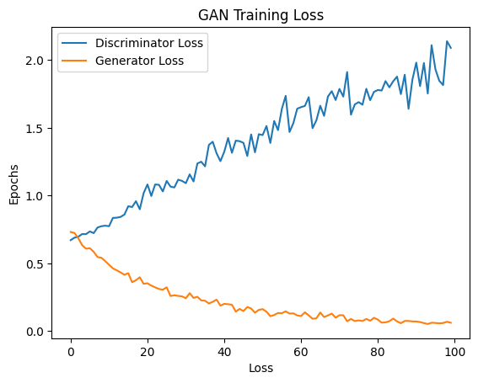
Result:

Slide 16
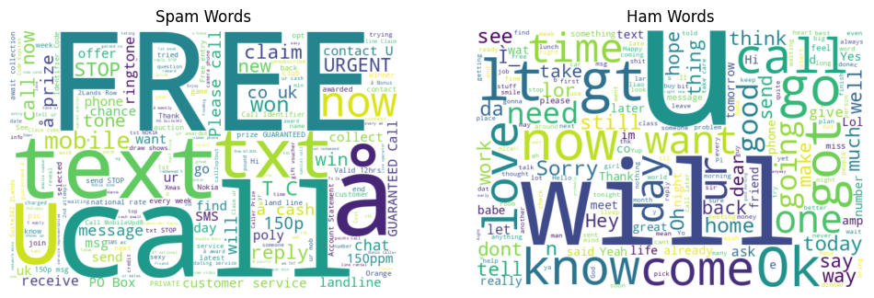
Result:(contd…)

Slide 17
References:
https://www.tensorflow.org/
https://numpy.org/
https://scikit-learn.org/stable/
https://keras.io/
https://matplotlib.org/
https://www.kaggle.com/datasets/uciml/sms-spam-collection-dataset

Slide 18
Conclusion:
SMS spam detection is vital for ensuring a clean and secure messaging experience. By employing preprocessing techniques and machine learning algorithms, we can effectively distinguish between spam and legitimate messages. Integrating the model into SMS gateways enables real-time prediction and response, enhancing user safety. Continuous monitoring and periodic model updates are essential for maintaining robust spam detection systems in the ever-evolving landscape of spam.

Slide 19
Thank you

